Slide 1

Medical Store-Distributor-Consumer Network
Proposal and Feasibility Presentation Template
Abdulla Iqbal FA17-BSE-030
Armaghan Hassan FA17-BSE-045
Majid Durani FA17-BSE-021
Supervisor: Sir Kashif Nasir
Department of Computer Science
COMSATS University Islamabad, Abbottabad Campus

Slide 2
Agenda of the Presentation
The agenda is to find out the feasibility report of the project.
Motivation
Introduction
Scope
Functionalities
Proposed Tools/Platform
Feasibility
Schedule
Tasks for 1st Iteration (or 30%)

Slide 3
Motivation
To develop an interactive Website, which will enable both companies and retailers to manage their stock and to get rid of medicine shortage problem.
It will make it easier for them to keep track of their inventory and will maintain the information of their buying and selling.
This method is all on paper we are digitalizing this all.

Slide 4
Brief Introduction
The Medical Store Distributor Consumer Network (MSDCN) is a medicine stock inventory system which will be used in Medical store and Pharmaceutical companies. This website will store details of medicine purchase and selling. The system will maintain purchases and selling detail w.r.t retailer and company. The system will consist of automatic billing and reporting module. Furthermore the website will also help the shopkeeper to automatically place the order if the stock is short from the shop and will be able to see the status about his or her shipment.

Slide 5
Scope
Our system will target Medicine market.
The problem with current medicine market is that all the communication, transactions, order placing, and order delivery is based on paperwork and wire transfers which results in delays and no monitoring.
Our system will provide online platform for both Medical Stores and Pharmaceutical Companies.
It will allow them to monitor transaction, order details, order delivery status, point of sale details, inventory managements.
Physical Order Delivery will not be covered by this system.

Slide 6
Functionalities
Register Company or Retailer
Point of Sale
Inventory Mangment
Enable Guest Employee
Transactions Detail
Report Generation
Automatic Order Placement

Slide 7
Proposed Tools/Platform
Visual Studio Code
Android Studio
Star UML
MS Visio
Laravel Php Framework
Html, Css, Java Script

Slide 8


Feasibility
Technical feasibility
All the hardware is available like laptops and cell phones, and technically it is possible to make this project.
The API’s that will be used are:
Email Verification
Contact verification
Payment method

Slide 9
Feasibility
Financial feasibility
The tools which we will be using are free and there is no hardware, so no cost hence no financial feasibility is present.

Slide 10
Feasibility
Resource feasibility
Human resources Such as Team members and useable equipment (Laptops and Mobile phones) are available for the project.

Slide 11
Feasibility
Operational feasibility
Website and App developed will be officially released and no ethical problems will occur during development, human recourses will be available after the system has been installed.

Slide 12
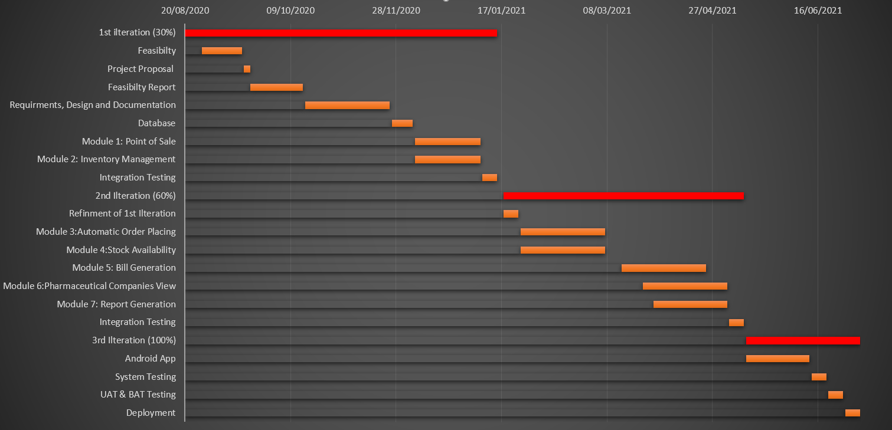
Schedule
Schedule (GANTT Chart)

Slide 13
Tasks for 1st Iteration (or 30%)
Software Requirements Specifications (SRS)
Software Design Specification (SDS)
Database
Back end logic of Point of Sale
Back end logic of Inventory management

Slide 14
Conclusion

